Slide 1
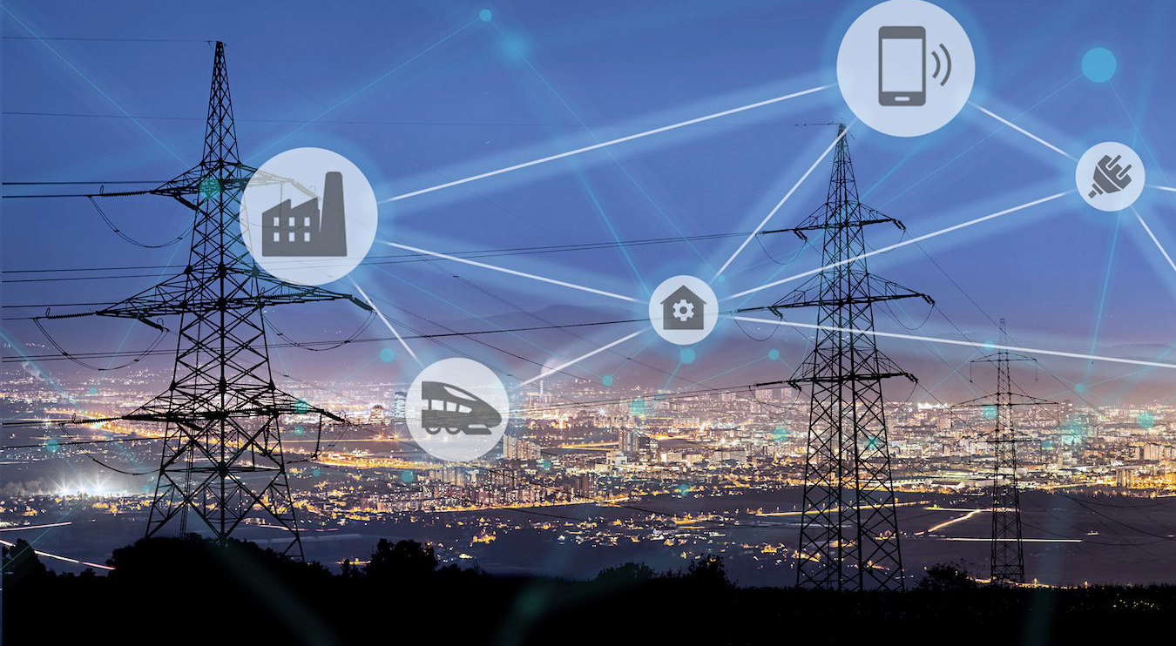
Smart Grid with Internet of Things
Krish Karki
Student Id:

Slide 2

Outline of Presentation
Introduction to Smart Grid
Importance of Smart Grid
Features of Smart Grid
Conceptual Model
Real Time Data Analysis
IoT role in Smart Grid
Challenges of Smart Grid implementation
Conclusion
Reference

Slide 3

Introduction
Internet of Things is now the talk of every city. It witnessed a tremendous growth in every sector. From connected medical devices, connected cars, roads to smart grids for energy management.
When we talk about energy management, smart grid is the first thing to appear. Internet of Things can play a significant role in developing smart grids which eventually leads to energy saving. IoT enabled smart grids are more about the energy efficiency and the management of energy consumption at the lowest cost.

Slide 4

What is Smart Grid
A Smart Grid is an electricity network that can intelligently integrate the actions of all users connected to it – generators, consumers and those that do both – in order to efficiently deliver sustainable, economic and secure electricity supplies.
Source: European Technology Platform Smart Grids

Slide 5
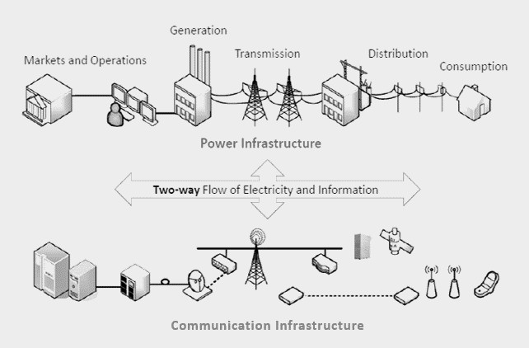
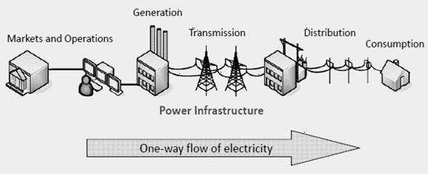
Traditional Power Grid
Smart Grid
vs

Slide 6

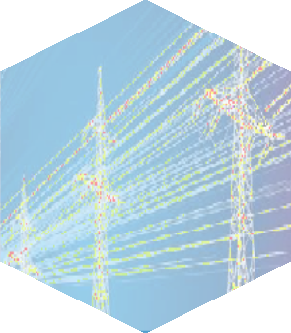





Why Smart Grid
Blackouts
New Types of Load. Ex.
Electrical Vehicle
Ageing
Infrastructure
Integration of Large Number of Renewable Generation Sources
Lower Carbon Emission Necessity

Slide 7








Feature of Smart Grid
Self-healing (from power disturbance events)
Optimizes operating efficiency
Operates resiliently against both
physical and cyber attacks
Provides quality power
Active participation by consumers in demand response
Optimizes asset utilization
Accommodates all generation and storage options.
Enables new electricity market

Slide 8
Conceptual Model
Smart Grid is a large
"System of Systems”.
According to Smart Grid Interoperability Standards Roadmap proposed by NIST the American National Institute of Standards and Technology, the conceptual architecture for smart grid is composed of seven big domains
Bulk Generation
Transmission
Distribution
Customers
Operations
Markets
Service Providers

Slide 9
Conceptual Model
All these functional domains have different inter and intra domain communications
Consumer domain is the user of electricity domain such as domestic, industrial, commercial or utilities.
Market domain refers to power market operators.
Operation domain deal with power supply management.
Service provider points service utilities companies providing customers with electrical power.
Bulk Generation, Transmission and Distribution refers to generation, storage, transmission and distribution of power to customers.
One of the key elements of smart grid’s successful operation is the interconnection of these seven domains.

Slide 10

Real Time Data Analysis
Continuous Monitoring
Predictive Maintainance
Fast Processing
IoT devices, such as sensors, smart meters, and other monitoring devices, are strategically placed throughout the smart grid infrastructure.
These devices continuously collect and transmit data in real-time, providing a detailed and up-to-date view of the grid's performance.
Real-time data analysis involves the rapid processing of incoming data streams as soon as they are generated.
Advanced analytics platforms and algorithms are employed to quickly analyze and interpret the data to extract actionable information.
By analyzing real-time data, predictive maintenance models can be implemented. These models use data patterns to predict when equipment is likely to fail or require maintenance.
This proactive approach helps utilities schedule maintenance activities more efficiently, reducing downtime and minimizing the risk of unexpected failures.

Slide 11
Real Time Data Analysis
Enhanced Decision Making
Efficiency Improvement
Integration with Control Systems
The immediate analysis of real-time data enables operators to identify issues or anomalies promptly.
Decision-makers can respond rapidly to changing conditions, helping to prevent or mitigate potential disruptions, optimize energy distribution, and ensure grid stability.
.
Real-time insights enable utilities to optimize energy distribution and grid operations dynamically.
Load balancing, fault detection, and other operational adjustments can be made promptly, leading to improved overall efficiency and reliability.
Real-time data analysis is often integrated with control systems that can automatically respond to identified issues.
Automated control mechanisms can adjust parameters or reroute power flow based on the analyzed data, contributing to a self-healing and adaptive grid.

Slide 12

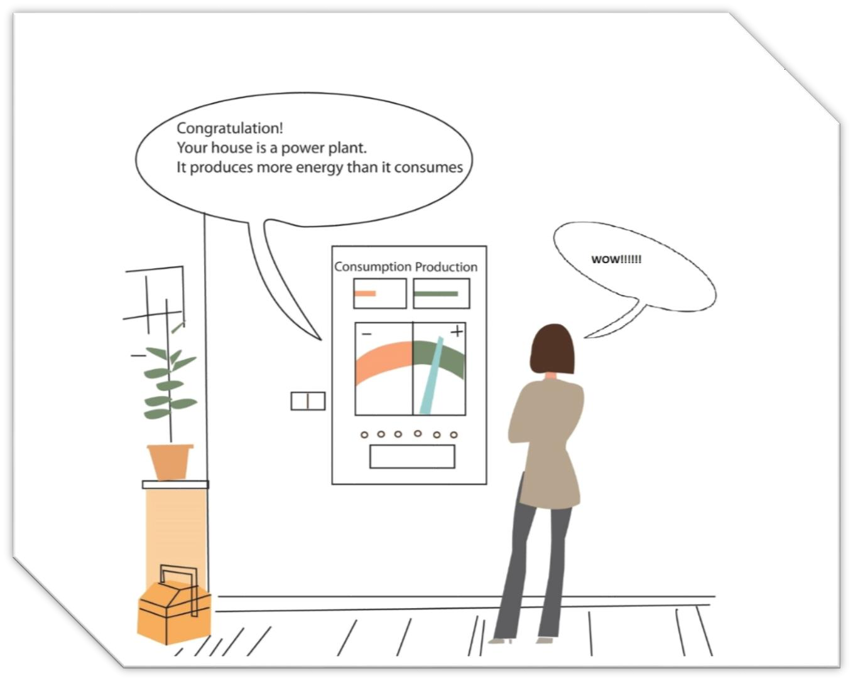
IoT Role in Smart Grid
Home energy management
IoT can play vital role to manage consumers’ energy consumption profiles according to real time electricity price.
IoT components collect energy requirements of different home appliances and send them to smart meters.
The control unit in smart grid schedules energy consumption of homes’ appliances by balancing user’s and utility companies’ preferences.
IoT enabled home storage devices intelligently interacts with the grid to understand the peak demand period and, if required, disconnects the home circuit from the grid to supply power on its own.
If required smart storage devices can add power supply to main grid. This two way electric flow convert consumer into prosumer.
Prosumer=Producer+ Consumer

Slide 13

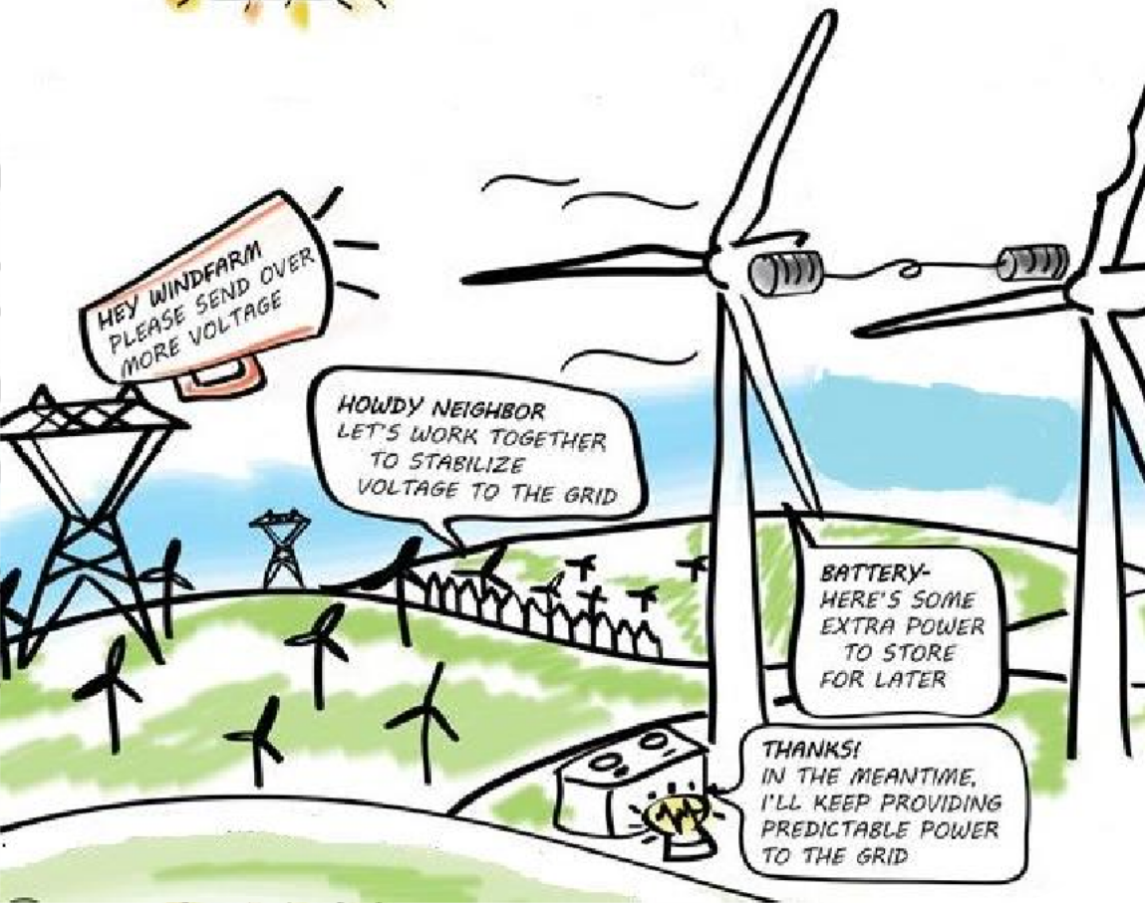
IoT Role in Smart Grid
Integration of renewable energy
Renewable energy generators are being combined into today’s power grid because of environmental reasons, climate change, and its low cost.
IoT technology uses wireless sensors to collect real-time weather information to help in predicting the energy availability in the near future.

Slide 14
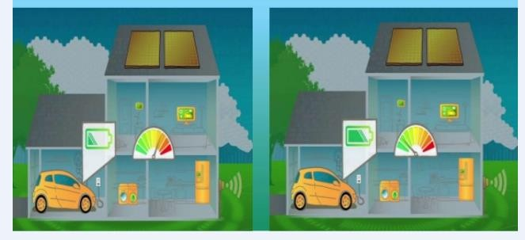
IoT Role in Smart Grid
Electrical Vehicles Tracking
Electric Vehicles (EVs) are used as energy storage devices while they are idle.
IoT enabled perception devices collects information about electric vehicles’
identity battery state location, etc,
to improve the efficiency of charging and discharging scheduling thus reduce emissions, shave peak load, and increase percentage of renewable power generation.

Slide 15
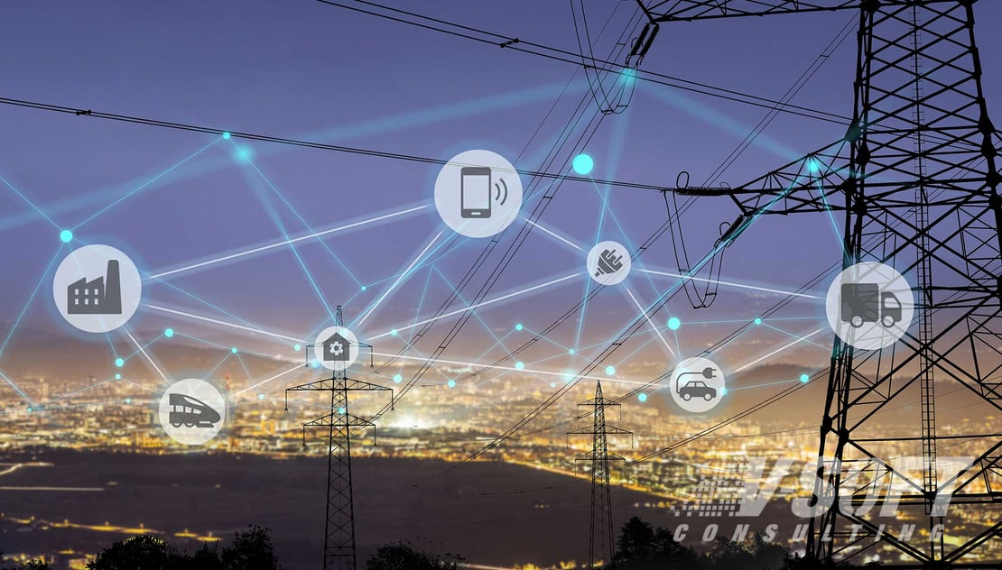
IoT Role in Smart Grid
Online Monitoring
IoT is deployed for continuous online monitoring of
power plant
transmission line distribution line energy consumption energy storage, etc.
.

Slide 16
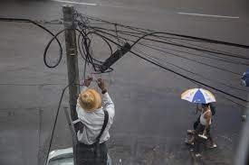
IoT Role in Smart Grid
Self-Healing
Deployment of IoT can also improve quality of smart grid’s self-healing feature. Sensors can detect
unpredictable conditions or breakdowns
and response rapidly. Smart grid may switch from grid to islanded mode and operate in it until system is stable or breakdown is fixed.

Slide 17
CHALLENGES
One of the biggest challenges of implementing millions of new devices for the Smart Grid is that each of these devices could become a potential target for hackers, being in this sense security a vital point to be solved with full safeguards against intrusion by a third party.
Ukraine attack is a wake-up call, this attack was relatively short-lived. The next one might not be.
Around 3:30p.m. December 23 ,2015 Ukraine witnessed its inaugural cyber-attack on a power system. Prykarpattya Oblenergo reported 27 substations outage, plunging 103 cities into complete darkness and leaving 186 partially affected. Simultaneously, a telephone denial-of-service attack paralyzed call centers, impeding blackout reports. Although power was restored swiftly, control centers remained compromised for over two months, underscoring the sophisticated and persistent nature of the cyber assault on Ukraine's energy infrastructure.

Slide 18
CHALLENGES
Deploying an IoT-enabled local smart grid involves installing numerous sensors, resulting in a significant amount of transferred data. Managing and storing this big data pose substantial challenges. Efficient interoperability between various communication networks is a critical concern in the deployment of smart grids. Addressing these challenges is essential for ensuring the seamless operation and optimization of the grid's performance, facilitating effective energy management and enhancing overall reliability.

Slide 19
Conclusion
The development of a smart grid is inevitable, and IoT emerges as a crucial solution for its support. Overcoming economic, policy, and technical hurdles is essential for successful IoT implementation in smart grids. Although the transition from traditional to smart grids is a prolonged process, widespread deployment of smart meters facilitates two-way communication, enabling control center interaction. Real-time pricing via smart meters empowers consumers to optimize energy usage, reduce peak demand, and capitalize on lower tariffs during off-peak hours. This not only minimizes blackout occurrences but also curtails carbon emissions, positioning the smart grid as a leader in green technology. Despite challenges, the shift toward a smarter, greener energy future is imperative.

Slide 20

References
NIST: National Institute of Standards and Technology framework and roadmap for smart grid interoperability standards, Release 1.0. visit http://www.nist.gov
B. Lichtensteiger, B. Bjelajac, C. Muller, C. Wietfeld, Rf mesh systems for smart metering: System architecture and performance, in: First IEEE International Conference on Smart Grid Communications(SmartGridComm), 2010, pp. 379–384.
W.Wang , Y.Xu, M.Khanna , “A survey on the communication architectures in smart grid”, “Computer Networks”, pp. 3604–3629,july 2011.
https://www.researchgate.net/publication/261793787_Internet_of_things_in_smart_grid_deploy
ment
Saida Elyengui, Riadh Bouhouchi, Tahar Ezzedine The Enhancement of Communication Technologies and Networks for Smart Grid Applications, visit http://www.ijettcs.org Email: editor
https://www.wired.com/2016/03/inside-cunning-unprecedented-hack-ukraines-power-grid

